Slide 1


Help starts here, Rhode Island.
2-1-1 and The POINT
Helping people in need.

Slide 2
2-1-1 Overview
Call Specialists provide assistance with information and referrals primarily for health and human services—including housing, shelter, food, utilities, gambling addiction, childcare, emotional crisis, aging and disability, health services information and enrollment, substance abuse, and much more.
2-1-1 offers call center services and walk-in services, mobile services on the outreach RV, and chat and text services at www.211ri.org.
Operates 24/7, 365 days per year.
Free, confidential, multilingual – English, Spanish, Portuguese, Khmer on staff, access to nearly 200 languages and dialects through language line.
Help starts here, Rhode Island.

Slide 3

Origin and Needs in 2018
By County: By Need:
Providence 115,774 Rental assistance 38,878
Kent 24,786 Utility assistance 56,633
Washington 9,770 Health information 54,957
Bristol 1,640 Food 62,326
Newport 4,860 Housing 72,944
Other (out-of-state/not identified) 24,543
Providence County
115,774
Bristol County
1,640
Kent County
24,786
Newport County
4,860
Washington County
9,770
Help starts here, Rhode Island.

Slide 4
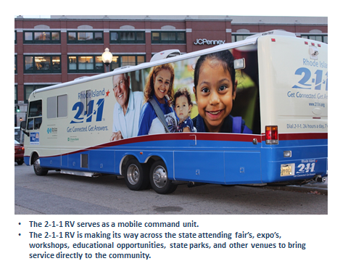
2-1-1 on the move in the community
The 2-1-1 RV serves as a mobile command unit.
The 2-1-1 RV travels statewide attending fairs, expos, workshops, educational events, state parks, and other venues to bring services directly to the community.
Help starts here, Rhode Island.

Slide 5
Services funded by the R.I. Division of Elderly Affairs (DEA)
Health Insurance & Access
Crisis Intervention & Support
Isolation & Neglect
Medicare and Medicaid Enrollment Program (MME)
State Health Insurance Enrollment
Senior Medicare Patrol
Navigator Program
After Hours Crisis Line
Emergency Response
Protective Services (Intake after hours)
Cybersecurity
Lifespan Respite
National Grid Partnership
Help starts here, Rhode Island.

Slide 6
What is The POINT?
Began in 2010.
Specialized information and referral services and options counseling for seniors, adults with disabilities, and caregivers.
Benefit Specialists provide assistance with enrollment into Medicare and Medicaid, prescription drug programs, additional health insurance plans, information for both public and private long-term care, housing options, and veteran benefits.
Benefit Specialists provide options counseling and wrap-around services.
Applications for home and community care, and other state services.
More than 40,000 contacts a year.
The POINT/ADRC is funded by the R.I. Division of Elderly Affairs.
Help starts here, Rhode Island.

Slide 7
Features of The POINT
Phone number for The Point: (401) 462-4444.
Call center hours: Monday, Wednesday, and Friday, 8:30 a.m. - 4:30 p.m. Tuesday and Thursday, 8:30 a.m. - 8 p.m. Saturday, 8:30 a.m. – noon.
Walk-in hours: Monday - Friday, 8:30 a.m. - 4:30 p.m.
4.65 full-time employees available during business hours.
Multilingual staff (English and Spanish).
Access to nearly 200 languages and dialects.
24/7 intake/triage through the 2-1-1 call center.
Help starts here, Rhode Island.

Slide 8

Our Mission
To empower individuals to make informed decisions, to exercise control over their long- and short-term care needs, to achieve their personal goals and preferences.
All incoming calls, walk-ins, and cases addressed on the outreach RV are provided with services and referrals according to their own individual needs.
Help starts here, Rhode Island.

Slide 9

The POINT in action
56,347 total contacts
47,543 total phone calls
2,536 in-person contacts
43,767 outreach contacts
Help starts here, Rhode Island.

Slide 10
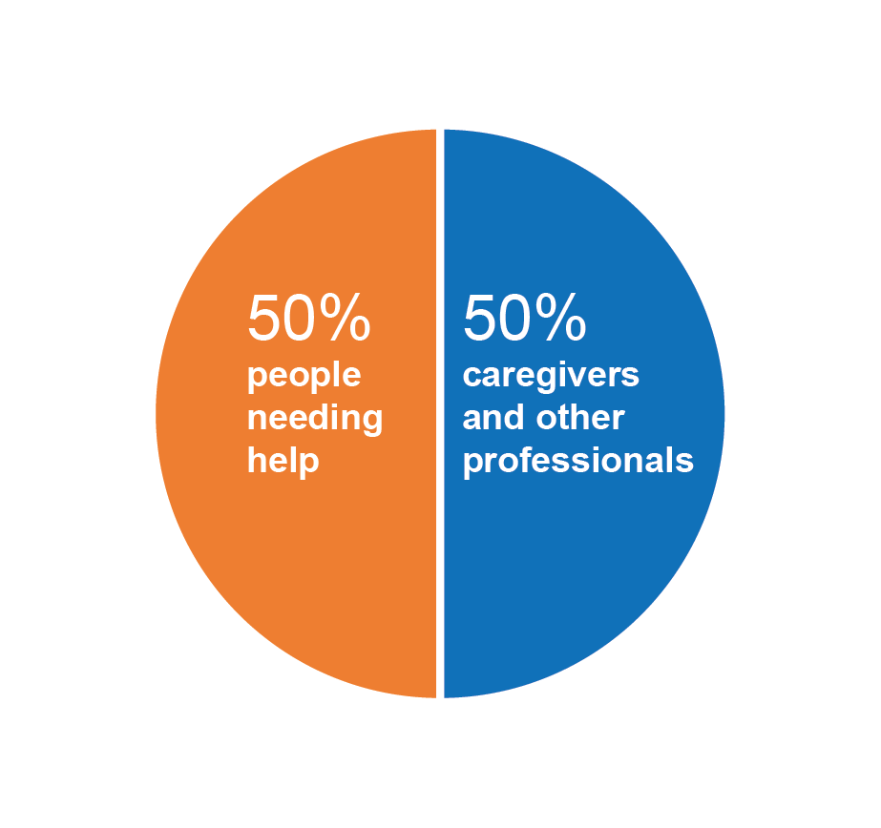
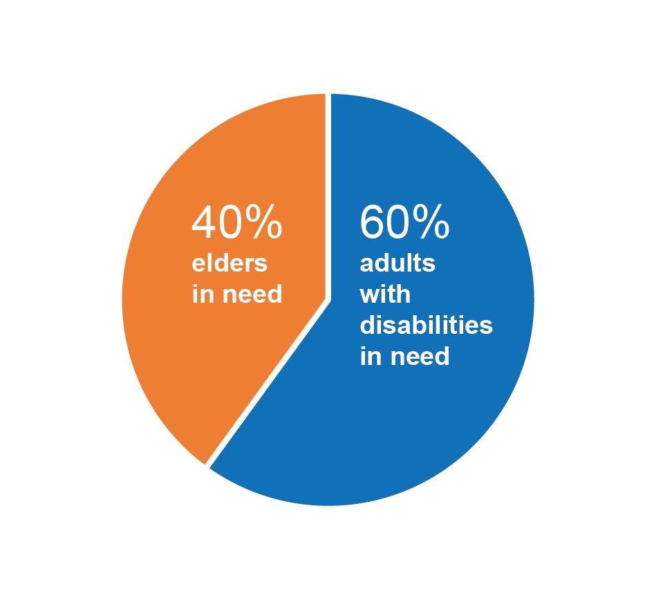
Complexity of Client Needs
The POINT receives two very distinct types of contacts:
Information and Referral Calls: average of 3,000 calls per month, up to five minutes per call.
Specialized Calls: up to 450 a month, up to two hours per call.
Who contacts The POINT?
Contacts might present one need, but usually receive services for four or more needs.
Help starts here, Rhode Island.

Slide 11

Older Adult needs are complex
A 73-year-old women, living in her car since May, has a feeding tube and is not allowed in shelters, because of the feeding tube. She has applied to Portsmouth Housing Authority. Her daughter lives locally and cannot let her mother stay with her because it is a lease violation. She is also a victim of domestic violence, and is trying to stay away from certain areas.
Help starts here, Rhode Island.

Slide 12
For more information about 2-1-1 in Rhode Island or The POINT, please contact:
Cristina Amedeo Managing Director 2-1-1/The POINT
Help starts here, Rhode Island.

